Slide 1
🌐
GLOBAL CYBERSECURITY THREATS
INTELLIGENCE DASHBOARD
A Comprehensive Analysis of Global Cyber Attack Patterns, Attack Types, Financial Impact & Risk Intelligence
TOOL USED- MICROSOFT POWER BI
PRESENTED BY-
DATA ANALYTICS BATCH-2 GROUP-D

Slide 2
DATASET DESCRIPTION
Overview
🌍 Country
🏭 Target Industry
This dataset provides a comprehensive view of global cybersecurity incidents across multiple countries and industries. It covers attack patterns, financial losses, affected users, and resolution strategies from 2015 to 2024.
The data consists of 3,000 records and is structured to support threat intelligence and risk analytics.
10 countries: Brazil, UK, India, Japan, USA, Russia, Australia, Germany, France, China
IT (478), Banking, Government, Healthcare, Retail, Education, Telecommunications
📅 Year
💰 Financial Loss
Dataset Components
Data spans 2015–2024, enabling decade-long trend analysis of cyber incidents
Average $50.49M per incident; total losses reveal significant economic impact
3,000
Total attack records spanning 2015–2024
10
Countries covered across Asia, Europe & Americas
⚔️ Attack Type
👥 Users Affected
7
Industries targeted (IT, Banking, Healthcare...)
DDoS (531), Phishing (529), SQL Injection (503), Ransomware (493), MitM (459), Malware (485)
1.51 Billion total users affected; reveals scale and breadth of cyber attacks
6
Attack types including DDoS, Phishing, Ransomware...

Slide 3
OBJECTIVES OF THE ANALYSIS
Problem Statement
01
Analyze global cyber attack trends by year, country, and industry
Organizations globally lack a unified intelligence system to monitor, correlate, and analyze cybersecurity threats in real time. This results in:
• Delayed incident detection and response
• Insufficient visibility into cross-industry attack patterns
• Poor understanding of financial exposure per attack type
• Inability to correlate threat sources with vulnerabilities
The goal is to develop an analytical solution that integrates multi-country, multi-industry threat data to deliver actionable cyber intelligence.
02
Identify top attack types and their financial & user impact
03
Evaluate security vulnerability types driving cyber incidents
04
Assess incident resolution time across different attack categories
05
Build a heatmap of financial loss by industry and attack type
06
Support strategic cybersecurity decision-making via interactive dashboards

Slide 4
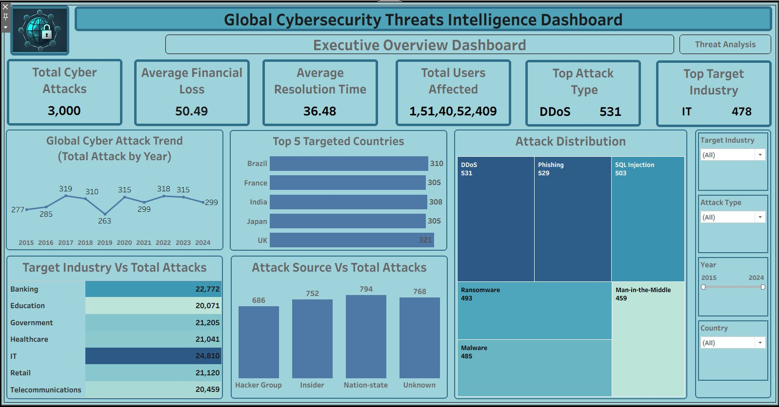
EXECUTIVE OVERVIEW DASHBOARD

Slide 5
EXECUTIVE OVERVIEW — KEY OBSERVATIONS & INSIGHTS
Total Cyber Attacks
Avg Financial Loss
Avg Resolution Time
Total Users Affected
Top Attack Type
Top Target Industry
3,000
$50.49M
36.48 hrs
1.51B
DDoS
IT
Incidents recorded
Per incident
Incident response
Across all attacks
531 incidents
478 incidents
Key Observations
Business Insights
Total cyber attacks stand at 3,000, spread across 10 countries and 7 industries over a decade (2015–2024).
DDoS dominance requires robust traffic-filtering and CDN-based mitigation strategies at the network perimeter.
DDoS is the most frequent attack type (531 incidents), while Phishing follows closely at 529 incidents.
IT sector concentration indicates critical infrastructure is under continuous adversarial pressure.
IT sector is the most targeted industry (478 attacks), reflecting its critical digital infrastructure.
UK and Brazil emerging as top targets warrants country-specific threat intelligence frameworks.
UK leads all countries with 321 attacks, followed by Brazil (310) and India (308).
High unknown-source attribution underscores the need for improved threat actor fingerprinting & OSINT.
Attack volumes show fluctuation year-over-year, peaking in 2016 (319) and declining to 299 by 2024.
Nation-state actors demand diplomatic and defense-grade cybersecurity coordination.
Unknown attack sources account for 768 incidents — the highest — suggesting attribution challenges.
Attack volume variability year-to-year suggests evolving attacker motivations and geopolitical triggers.
Nation-state and Insider threats together represent over 1,500 incidents, signaling advanced threat actors.
Multi-industry spread highlights need for cross-sector information sharing and unified SIEM platforms.

Slide 6
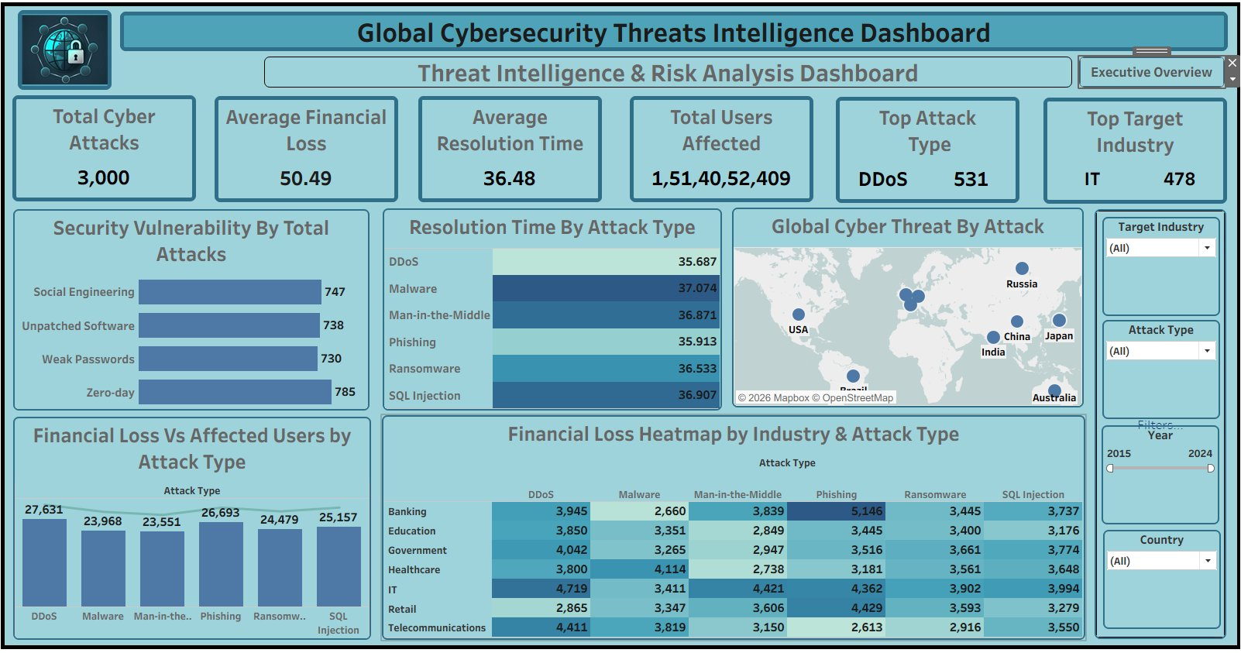
THREAT INTELLIGENCE & RISK ANALYSIS DASHBOARD

Slide 7
THREAT INTELLIGENCE — KEY OBSERVATIONS & INSIGHTS
Resolution Time by Attack Type (hrs)
Security Vulnerability by Total Attacks
Financial Loss (Avg $M) vs. Users Affected
by Attack Type
DDoS
35.69
Social Engineering
747
DDoS
27,631
Malware
37.07
Unpatched Software
738
Malware
23,968
Man-in-the-Middle
36.87
Man-in-the-Middle
23,551
Phishing
35.91
Weak Passwords
730
Phishing
26,693
Ransomware
36.53
Zero-day
785
Ransomware
24,479
SQL Injection
36.91
SQL Injection
25,157

Slide 8
ATTACK TYPE & SOURCE ANALYSIS
Attack Distribution
Attack Source vs Total Attacks
DDoS
531
Phishing
529
SQL Injection
503
752
794
768
686
Malware
485
Man-in-the-Middle
459
Hacker Group
Insider
Nation-state
Unknown
Key Observations
DDoS leads all attack types at 531 incidents, highlighting network-layer threats as the primary concern.
Unknown sources (768) are the most common attack origin, emphasizing attribution gaps in threat intelligence.
Nation-state actors (794) represent the most identified threat source, pointing to geopolitical cyber warfare.
SQL Injection (503) remains prevalent, indicating systemic application-layer security weaknesses across industries.

Slide 9
FINANCIAL IMPACT ANALYSIS — LOSS HEATMAP BY INDUSTRY & ATTACK TYPE
DDoS
Malware
Man-in-the-Middle
Phishing
Ransomware
SQL Injection
Banking
3,945
2,660
3,839
5,146
3,445
3,737
Education
3,850
3,351
2,849
3,445
3,400
3,176
Government
4,042
3,265
2,947
3,516
3,661
3,774
Healthcare
3,800
4,114
2,738
3,181
3,561
3,648
IT
4,719
3,411
4,421
4,362
3,902
3,994
Retail
2,865
3,347
3,606
4,429
3,593
3,279
Telecommunications
4,411
3,819
3,150
2,613
2,916
3,550
💡 Key Insight:
IT sector under Phishing attacks records the highest financial loss ($4,362). Banking-Phishing ($5,146) is the single most expensive combination. Healthcare-Malware ($4,114) and IT-DDoS ($4,719) are critical exposure points demanding priority investment in detection and response.

Slide 10
INDUSTRY & COUNTRY ANALYSIS
Target Industry vs Total Attacks
Top 5 Targeted Countries
IT
24,810
UK
321
Brazil
310
Banking
22,772
India
308
Government
21,205
Japan
305
France
305
Retail
21,120
Global Cyber Attack Trend (by Year)
Healthcare
21,041
319
310
315
299
318
315
299
Telecommunications
20,459
277
285
263
Education
20,071
15
16
17
18
19
20
21
22
23
24

Slide 11
CONCLUSION & RECOMMENDATIONS
Conclusion
Recommendations
Global cyber threats are persistent and diverse, with 3,000 recorded incidents across 10 countries and 7 industries.
01
Deploy AI-powered DDoS mitigation and traffic anomaly detection at network perimeter.
DDoS and Phishing are the dominant attack vectors, requiring immediate and sustained defensive focus.
02
Implement Zero Trust Architecture (ZTA) to reduce lateral movement risk after breaches.
IT and Banking sectors face the highest exposure, with financial losses and user impact concentrated in these verticals.
03
Prioritize patch management programs with SLA-bound vulnerability remediation timelines.
Zero-day vulnerabilities (785) are the most exploited weakness, highlighting the urgent need for proactive patch management.
04
Invest in Security Operations Centers (SOC) to reduce average resolution time below 24 hours.
Nation-state actors represent the most impactful identified threat source, demanding geopolitical-level response frameworks.
05
Establish cross-industry threat-sharing platforms (ISACs) to improve collective defense intelligence.
Average incident resolution time of 36.48 hours signals significant room to improve detection-to-response efficiency.
06
Mandate multi-factor authentication across all enterprise systems to counter phishing and MitM.
Financial losses exceeding $50M per incident underscore the critical importance of proactive cybersecurity investment.
07
Conduct regular cyber war-game exercises to test incident response readiness and reduce financial exposure.

Slide 12
🌐
THANK YOU
Global Cybersecurity Threats Intelligence Dashboard
Powered by Microsoft Power BI
PRESENTED BY-
DATA ANALYTICS BATCH-2 GROUP-D

